Slide 1
How to Make a Mind Map in Visio
What is Visio?
Visio is a part of the Microsoft family used for drawing different types of diagrams for professional use. This diagramming software supports the creation of templates and symbols. Thus, allowing users to draw flowcharts, organizational charts, network diagrams, mind maps, floor plans, infographics, and other diagramming needs.

Slide 2

Five steps for making a mind map in Visio
Step 1: Launching the application:
Open the desktop version or the web version of Visio on your screen. If you do not have the software with you, install the same in your system. Remember, since the software is expensive, choose between Plan 1 or 2 per your requirement.

Slide 3
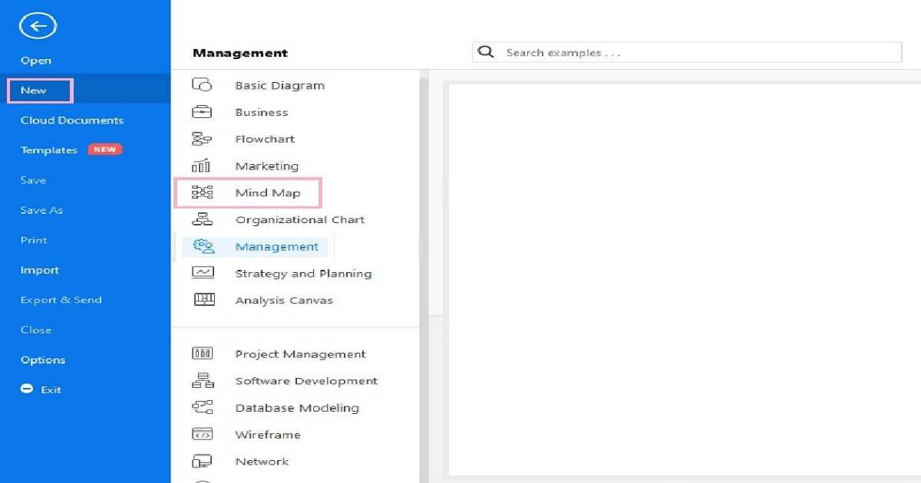
Step 2: Selecting the template:
Brainstorm diagram is the name used against a mind map in Visio. You can either select a template or draw the map from scratch. Visit the template gallery to choose the brainstorm diagram template, select the template and start making your mind map diagram in Visio.
Check for Brain storming

Slide 4
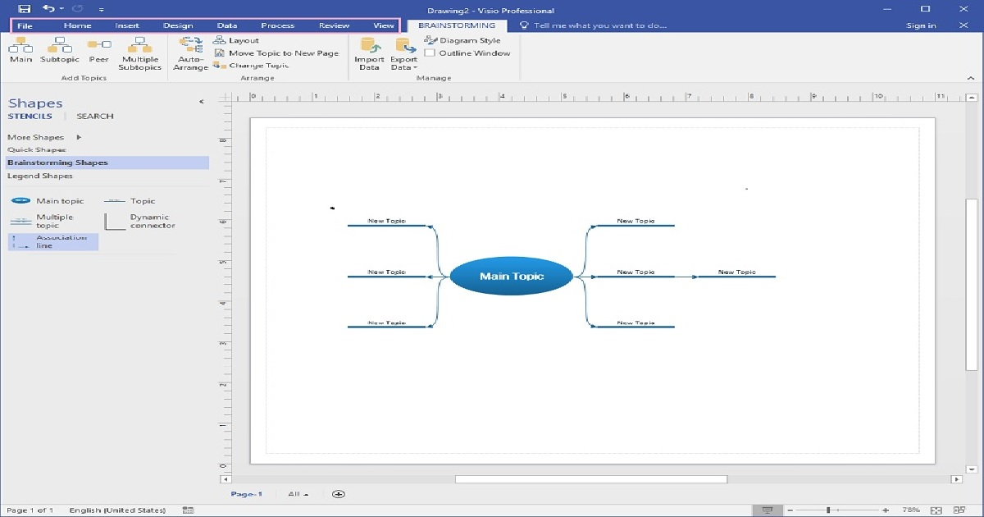
Step 3: Creating the mind map using shapes:
You can choose brainstorming shapes to draw the mind map diagram from scratch. Go to More Shapes> Business> Brainstorming. Click New and go to the sub-menu that appears.
Click on the Brainstorming tab, go to More Shapes and click on Brainstorming Shapes. Here you will get various shapes. Create your desired mind map by selecting one of them.

Slide 5
Step 4: Customize the diagram:
Once you have decided the mode of your mind map drawing and got the diagram elements together, it is time for you to customize it according to the requirements. Go to the Brainstorming ribbon and use the different tools to format your mind map. You can also make quick changes to the map by using the short-cut menu.

Slide 6
How to make a mind map in Visio? Launching the application.
Selecting the template.
Create the mind map using shapes.
Customize the diagram.
Save the diagram.

